Slide 1
COMP10001
Week 9

Slide 2
What is a “list comprehension”? How do we write one and how do they simplify our code?

Slide 3
What is a “list comprehension”? How do we write one and how do they simplify our code?
A cheeky shortcut for simple iteration tasks involving a collection (i.e. list, set, dictionary)

Slide 4
What is a “list comprehension”? How do we write one and how do they simplify our code?
A cheeky shortcut for simple iteration tasks involving a collection (i.e. list, set, dictionary)
[<expression> <for iteration statement> <optional if filter condition>]

Slide 5
What is a “list comprehension”? How do we write one and how do they simplify our code?
A cheeky shortcut for simple iteration tasks involving a collection (i.e. list, set, dictionary)
[<expression> <for iteration statement> <optional if filter condition>]
For each iteration, the outcome of <expression> is added to the collection
If the <if filter condition> is included, this only happens when the condition is True

Slide 6
What is a “list comprehension”? How do we write one and how do they simplify our code?
A cheeky shortcut for simple iteration tasks involving a collection (i.e. list, set, dictionary)
[<expression> <for iteration statement> <optional if filter condition>]
For each iteration, the outcome of <expression> is added to the collection
If the <if filter condition> is included, this only happens when the condition is True
Avoid overcomplicating these! They’re a neat way to wrap up simple loops into one line!

Slide 7
What happens if we use curly brackets instead of square brackets around a list comprehension? How about parentheses?

Slide 8
What happens if we use curly brackets instead of square brackets around a list comprehension? How about parentheses?
[i**2 for i in range(10)] -> list!
{i**2 for i in range(10)} -> set!

Slide 9
What happens if we use curly brackets instead of square brackets around a list comprehension? How about parentheses?
[i**2 for i in range(10)] -> list!
{i**2 for i in range(10)} -> set!
(i**2 for i in range(10)) -> NOT a tuple!
This is a generator, which we can iterate over. You don’t need to know about generators, but you do need to know that this expression doesn’t give us a tuple!

Slide 10
Exercise!
Evaluate the following list comprehensions. Also, write some equivalent Python code that doesn’t use a comprehension.

Slide 11
Why do we use files? Could we use computers without them?

Slide 12
Why do we use files? Could we use computers without them?
Files store data permanently - they persist after a program is terminated

Slide 13
Why do we use files? Could we use computers without them?
Files store data permanently - they persist after a program is terminated
That’s different to internal data storage like lists and dictionaries - they are in temporary memory and are erased when the program finishes

Slide 14
Why do we use files? Could we use computers without them?
Files store data permanently - they persist after a program is terminated
That’s different to internal data storage like lists and dictionaries - they are in temporary memory and are erased when the program finishes
Files also allow us to organise/structure our data …

Slide 15
Why do we use files? Could we use computers without them?
Files store data permanently - they persist after a program is terminated
That’s different to internal data storage like lists and dictionaries - they are in temporary memory and are erased when the program finishes
Files also allow us to organise/structure our data …
… and share it!

Slide 16
What are the steps to reading and writing files?

Slide 17
What are the steps to reading and writing files?
In Python, to open a file we use the open() function, which has two arguments:
open(<filename>, <mode>)

Slide 18
What are the steps to reading and writing files?
In Python, to open a file we use the open() function, which has two arguments:
open(<filename>, <mode>)
<mode> defaults to “r”, for reading
<mode> could also be set to <w> for writing
The contents of a file, if it already exists, are overwritten
… Or <a> for appending to a file that already exists

Slide 19
What are the steps to reading and writing files?
In Python, to open a file we use the open() function, which has two arguments:
open(<filename>, <mode>)
<mode> defaults to “r”, for reading
<mode> could also be set to <w> for writing
The contents of a file, if it already exists, are overwritten
… Or <a> for appending to a file that already exists
To read a file, we can use:

Slide 20
What are the steps to reading and writing files?
In Python, to open a file we use the open() function, which has two arguments:
open(<filename>, <mode>)
<mode> defaults to “r”, for reading
<mode> could also be set to <w> for writing
The contents of a file, if it already exists, are overwritten
… Or <a> for appending to a file that already exists
To read a file, we can use:
file.read() for a whole file
file.readline() to read one line of a file, as a string
file.readlines() to read an entire file, returning a list with each row of the file a string in the list

Slide 21
What are the steps to reading and writing files?
In Python, to open a file we use the open() function, which has two arguments:
open(<filename>, <mode>)
<mode> defaults to “r”, for reading
<mode> could also be set to <w> for writing
The contents of a file, if it already exists, are overwritten
… Or <a> for appending to a file that already exists
To read a file, we can use:
file.read() for a whole file
file.readline() to read one line of a file, as a string
file.readlines() to read an entire file, returning a list with each row of the file a string in the list
To write a file, we use file.write() to write a string to the output

Slide 22
What are the steps to reading and writing files?
In Python, to open a file we use the open() function, which has two arguments:
open(<filename>, <mode>)
<mode> defaults to “r”, for reading
<mode> could also be set to <w> for writing
The contents of a file, if it already exists, are overwritten
… Or <a> for appending to a file that already exists
To read a file, we can use:
file.read() for a whole file
file.readline() to read one line of a file, as a string
file.readlines() to read an entire file, returning a list with each row of the file a string in the list
To write a file, we use file.write() to write a string to the output
When we’re done, we close the file, with file.close()

Slide 23
What is a “csv” file and why is it useful for storing and manipulating data?

Slide 24
What is a “csv” file and why is it useful for storing and manipulating data?
A comma separated values file is a text file stored in a specific format, like a spreadsheet

Slide 25
What is a “csv” file and why is it useful for storing and manipulating data?
A comma separated values file is a text file stored in a specific format, like a spreadsheet
Rows of data with individual values, separated by a comma (,) and rows separated by a newline character (\n)

Slide 26
What is a “csv” file and why is it useful for storing and manipulating data?
A comma separated values file is a text file stored in a specific format, like a spreadsheet
Rows of data with individual values, separated by a comma (,) and rows separated by a newline character (\n)
When we’re using data, it’s often natural to store it in rows and columns
So csvs are very powerful!

Slide 27
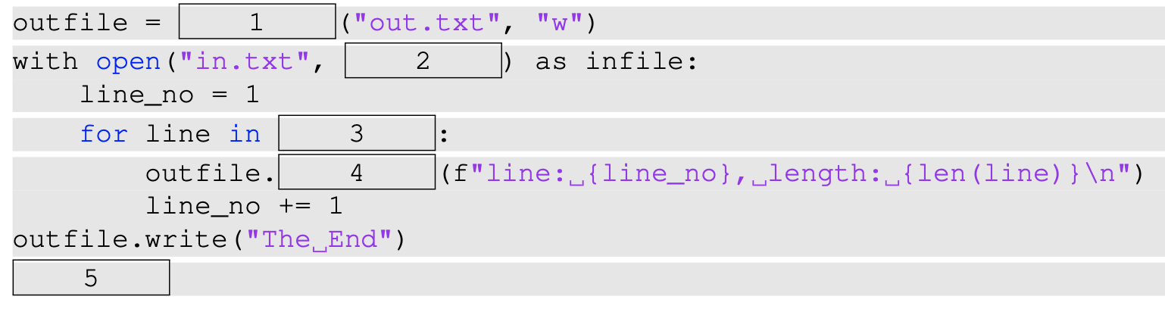
Fill in the blanks!

Slide 28
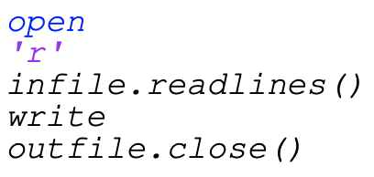
Fill in the blanks!

Slide 29
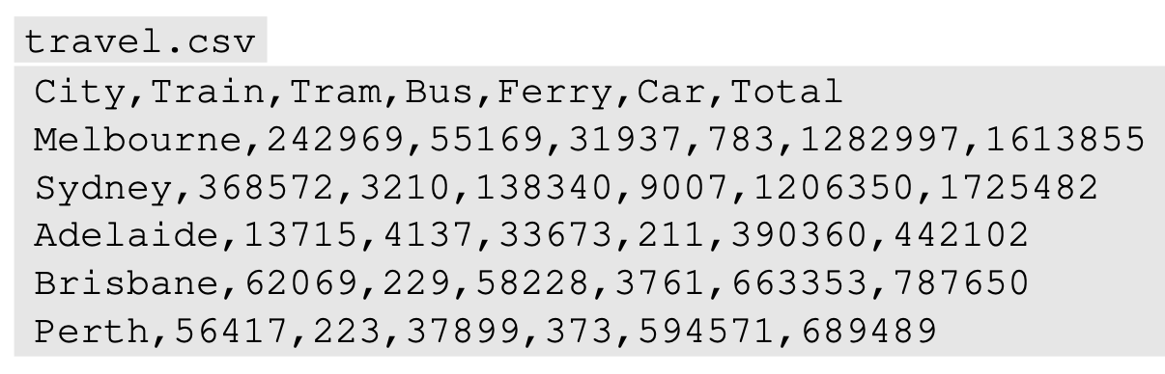
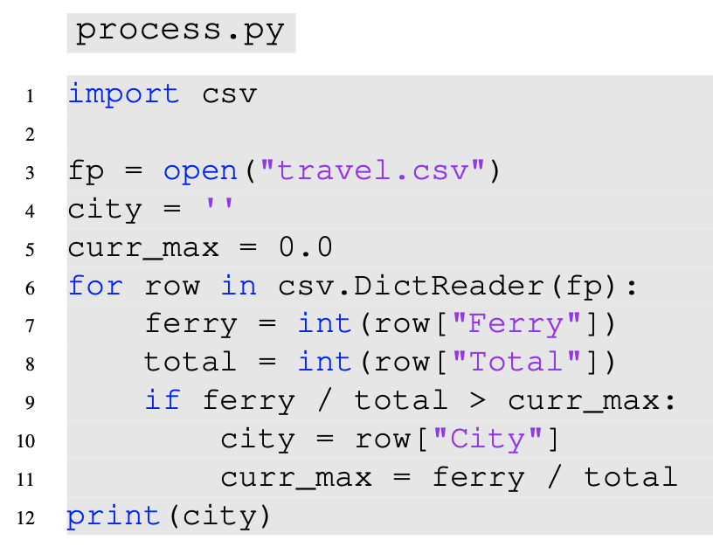
Given the following csv file and Python script, what is the code attempting to find and print?

Slide 30
Using a list comprehension, (re)write the function allnum that takes a list of strings, and returns a list of those that exclusively contain digits

Slide 31
Using a list comprehension, (re)write the function allnum that takes a list of strings, and returns a list of those that exclusively contain digits

Slide 32
Using a list comprehension, (re)write the make_gamertag function that takes a name string and returns a string with a hyphen after each letter

Slide 33
Using a list comprehension, (re)write the make_gamertag function that takes a name string and returns a string with a hyphen after each letter

Slide 34
